Slide 1
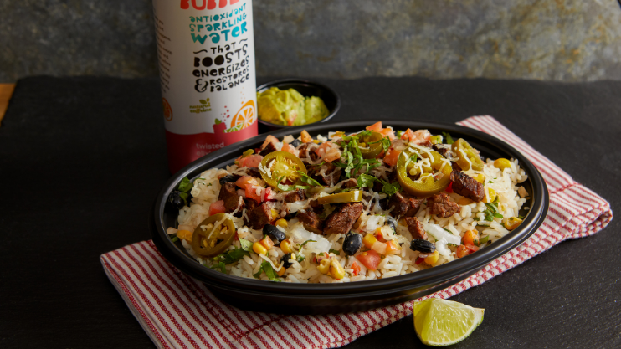

Process Improvements for South Cantina
ISyE 320: Group 5
By: Aditya Narasimhan, Ty Mountain, Olivia Balara, Nandini Jagtiani
Notes:
Olivia

Slide 2
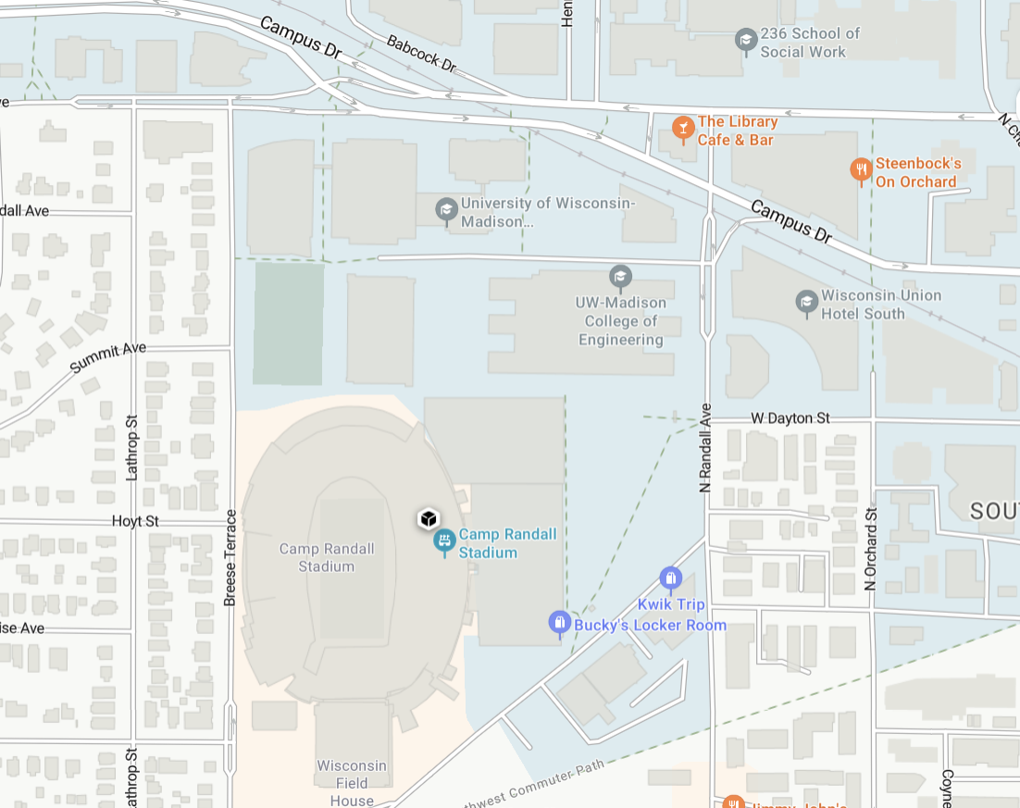

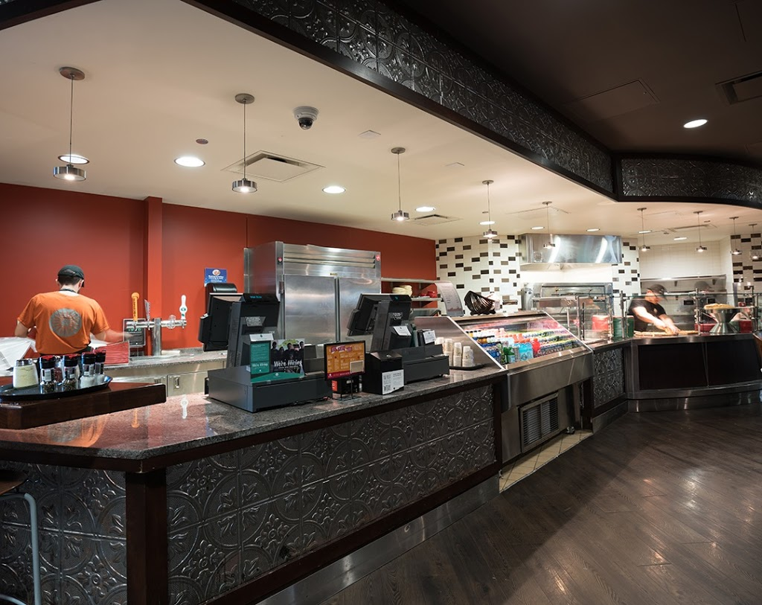
Overview of South Cantina
Customizable orders for Mexican cuisine; burritos, nachos, tacos, and bowls.
Location: Union south
University owned
Notes:
Olivia

Slide 3
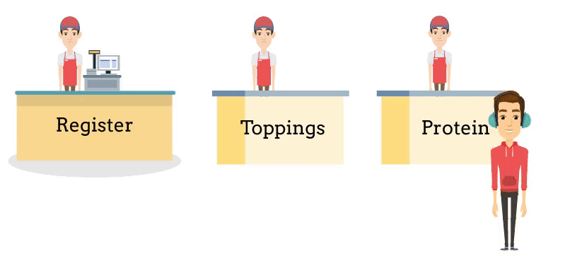
Overview of South Cantina
Counter style restaurant with sequential order stations
High customer flow during lunch hours (11 am to 2 pm)
Notes:
Olivia
Description of current system
PROTEIN and BASE STATION

Slide 4
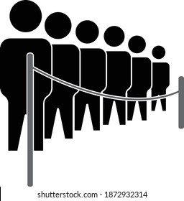
Problem Statement
Queue extends beyond the capacity of the restaurant’s designated area
KPI measured - Maximum queue length
Primary Goal – Maintain an average queue length of less than six entities
Secondary Goal – Ensure the queue does not exceed eight entities
Notes:
Olivia
For any replications, across all replications.
Key performance Indicator: Maximum queue length
During peak times, the queue often extends beyond the capacity of the restaurant’s designated area, reaching into common walkways and causing congestion
Primary Goal – Maintain a queue length of six entities to accommodate all customers within the designated area
Secondary Goal – Ensure the queue does not exceed eight entities across any replications to prevent overflow

Slide 5

Current State Simulation
A dynamic simulation was created to study potential process improvements
Customers arrive and flow through the three sequential processes
People icon represent base station queue
We estimated distributions used to model delays for each process
Customer Arrival
Base Station
Toppings Station
Register Station
Notes:
Ty
Explain what the hold does

Slide 6
Current State Analysis
Customer Arrival
Base Station
Toppings Station
Register Station
Collected data over the 4 days between 11am and 2pm
Histograms, parameter estimates, and validation tests confirmed these distributions
Distribution parameters were used to create the ARENA simulation
Process | Distribution (parameters in seconds)
Interarrivals | Exponential (lambda = 62.5)
Base Station | Normal (mean=29.3, standard deviation = 12)
Toppings Station | Normal (mean=40.2, standard deviation = 15.9)
Register Station | Normal (mean=22.7, standard deviation = 9.31)
Notes:
Ty
Explain what the hold does
Make the border orange

Slide 7
Current State Validation
Validation t-test Data (Average WIP)
Simulation visually face validates ✅
Simulation statistically validates when compared to system performance data ✅
Can move forward with using the simulation to evaluate potential improvements
| -1.36 | < 2.09
Notes:
Ty
Given that the simulation passes both the face validity and statistical test, the team is comfortable using this simulation for further experimentation

Slide 8
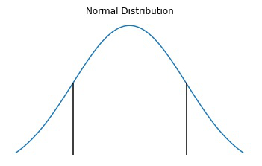
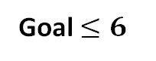
Baseline Simulation Performance
Current systems performance relative to KPI’s across 20 replications
Goal $≤6$
$$≤$$
50% chance that the KPI mean lies within the goal
95%
5.4022
6.9977
Confidence Interval of the Mean Maximum Queue Length
Notes:
Ty
As we can see, the simulated values using the collected data, for maximum base station queue length are larger than the goals for this KPI.
The confidence interval of the mean maximum queue length partially overlaps with the goal of less than 6. This demonstrates that there is a smaller than 50% chance that the KPI mean lies within the goal set by the team. Therefore, the system will require improvements to ensure with greater likelihood that the mean value of the KPI lies within the satisfactory region.

Slide 9
Tactical Improvement Proposal
Current State
Proposed State
Customer interacts with all three employees
Customer interacts with only one employee till the end
Motivation: Equal utilization of all employee decreases queue length
Notes:
Nandini
After passing both the face and statistical validation test, we started our first improvement which is the tactical improvement.
In the current system, a customer interacts with all three employees at the base station, toppings station as well as the register station. For our proposed system, each customer will only interact with one employee all the way to the register station similar to a conveyor system. Our motivation behind this was there is equal utilization amongst all employees, which further helps in decreasing the queue length

Slide 10
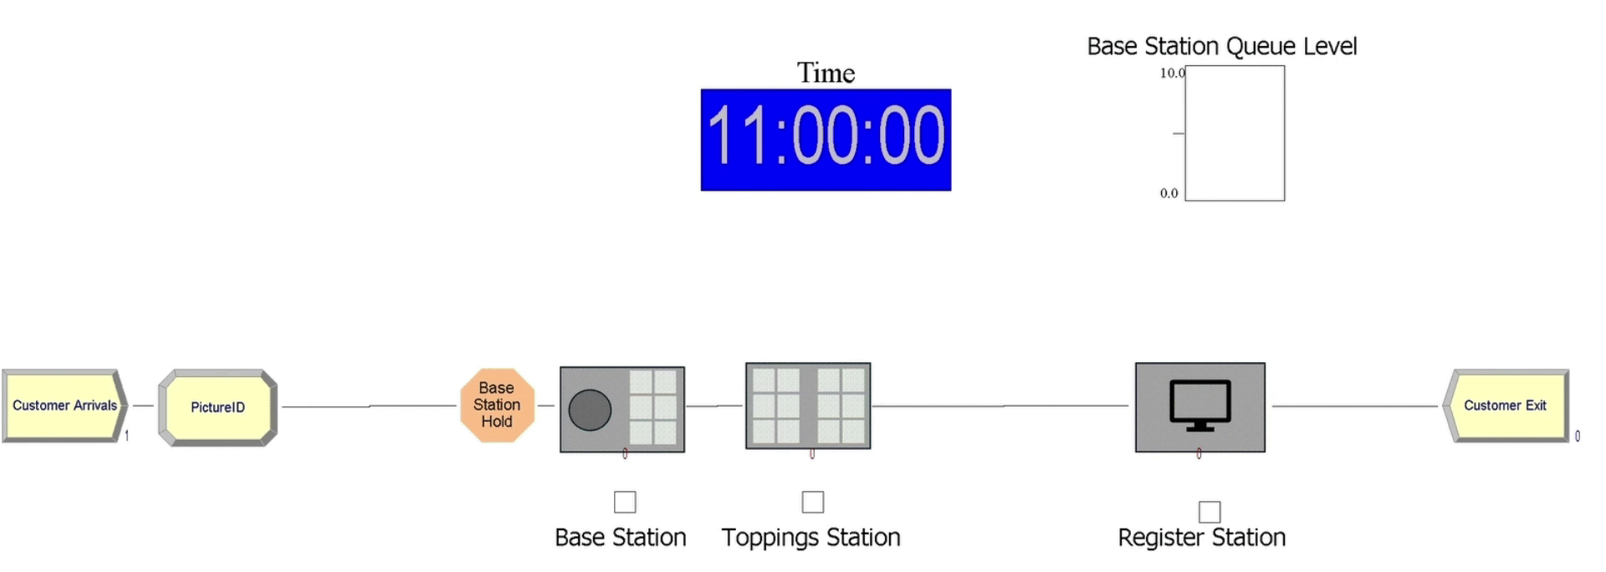
Tactical Improvement Proposal
Simulation Parameters
3 - hour day
Warm-up period – 0.5 hours
20 replications
Notes:
Nandini
We performed the simulation, keeping these simulation parameters in mind. As mentioned earlier, we collected data from 11am to 2 pm, hence a 3-hour day. Further we chose a half an hour warm up period to allow the system to fall into normal running conditions representing our improvement. From the simulation you can also notice the base station queue level, which is the first station of our system. The queue never crosses 5 entities which is a very good sign.

Slide 11
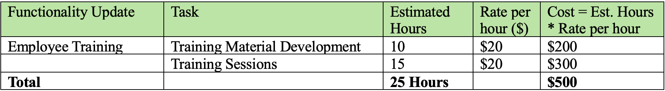
Tactical Improvement Proposal
Total cost ~ $500
$20 – Union South employee wages
Cost Analysis
Notes:
Nandini
We further performed a cost analysis for this improvement to discuss the feasibility. The total cost comes upto 500 dollars, with 200 for training material development and 300 for training sessions. Here the rate per hour value is taken from union south employee wages that currently work at south cantina. Since this was a small scale improvement, without acutally changing the entire system, we only had these two costs.

Slide 12

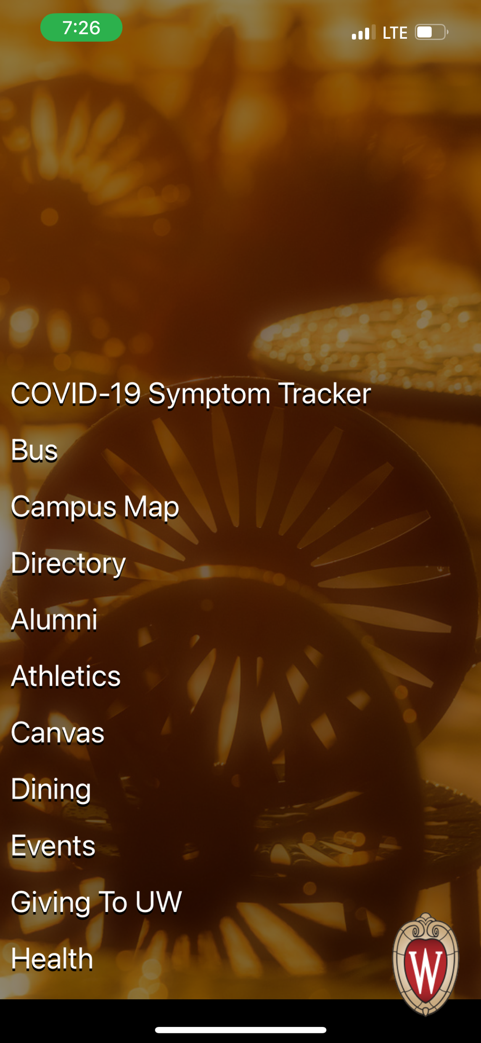
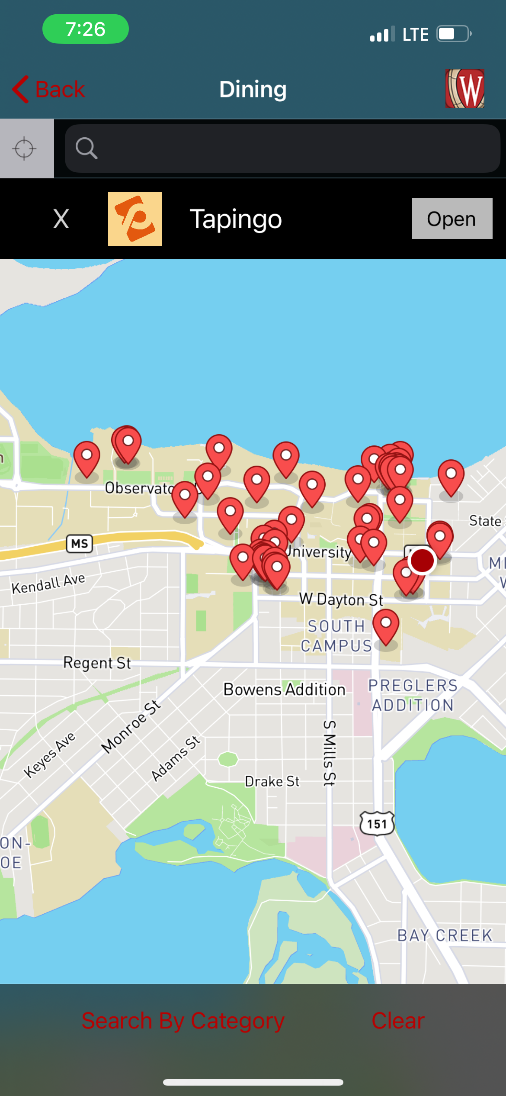
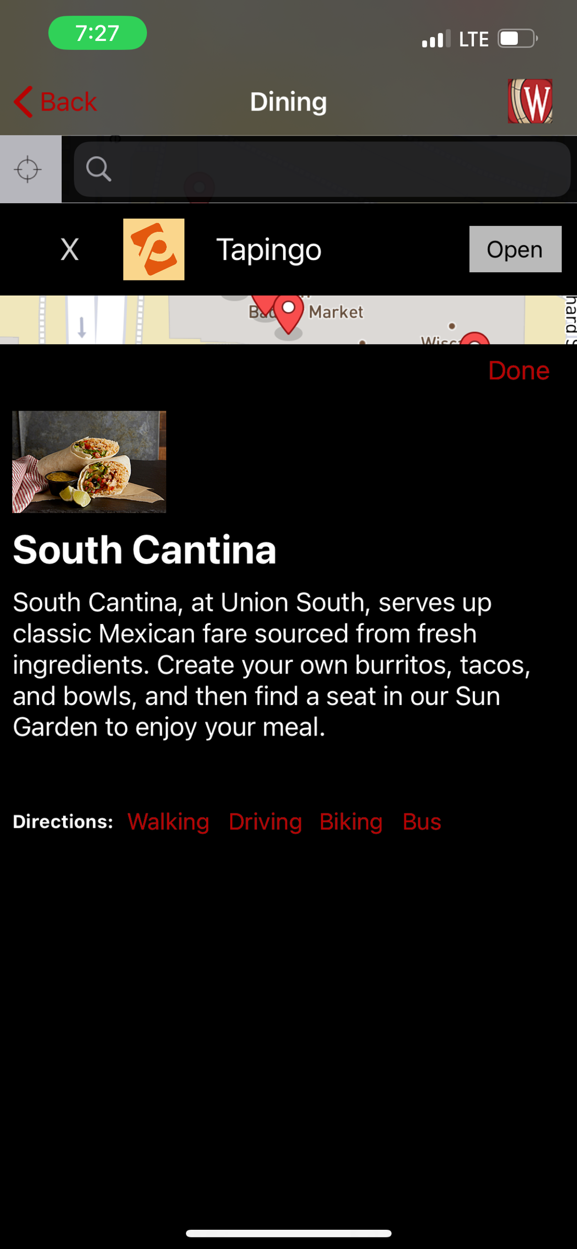

Strategic Improvement Proposal
Digital Ordering System
Motivation: Reduction in In-Person Queue due to customers adopting the digital ordering system
Wisconsin
Start Order
Notes:
Adi
We currently have an app called Wisconsin where…

Slide 13
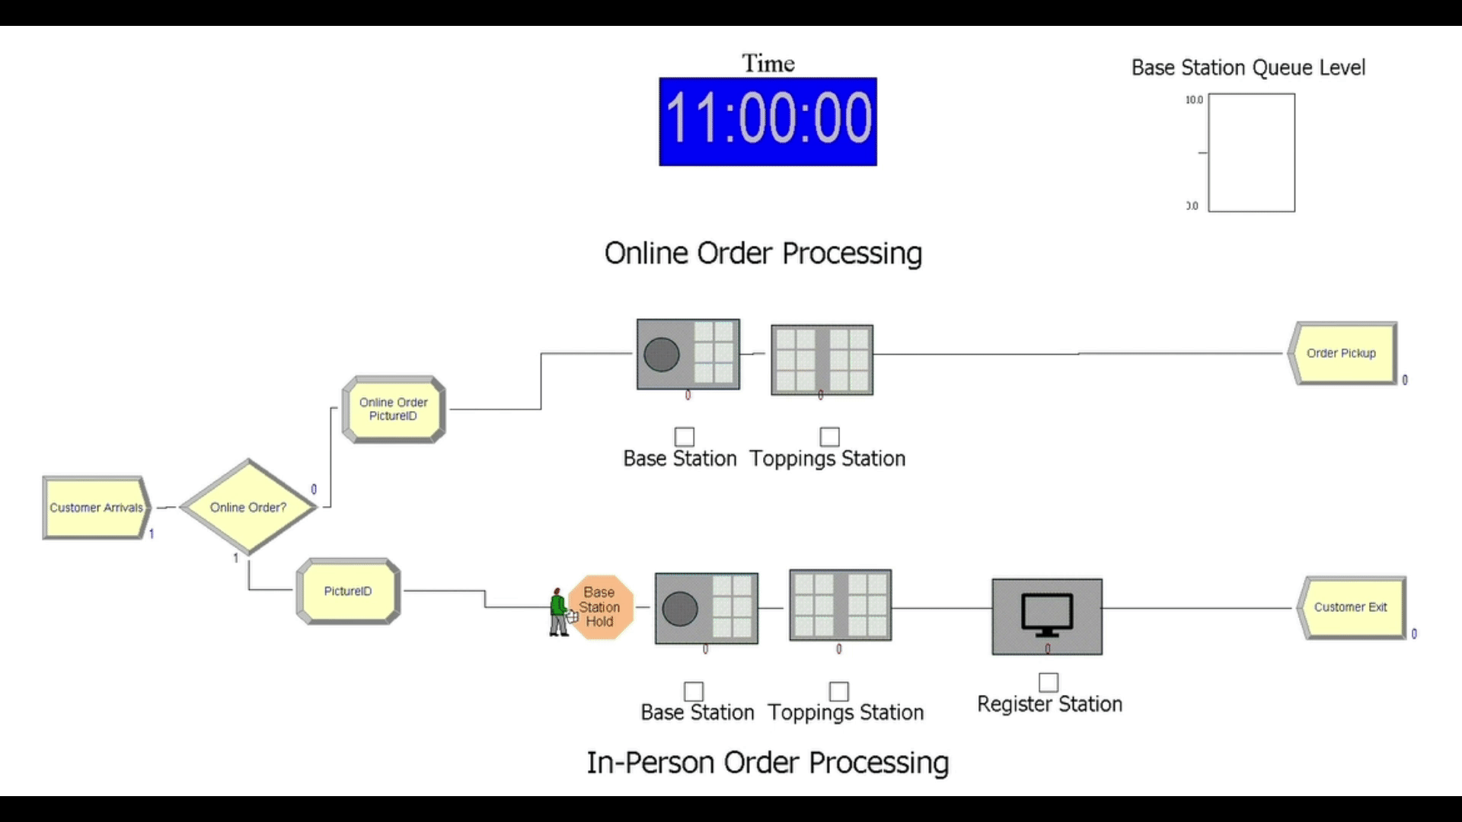
Strategic Improvement Proposal
Simulation Parameters
3 - hour day
Warm-up period – 0.5 hours
20 replications
Notes:
Adi
Need to add

Slide 14
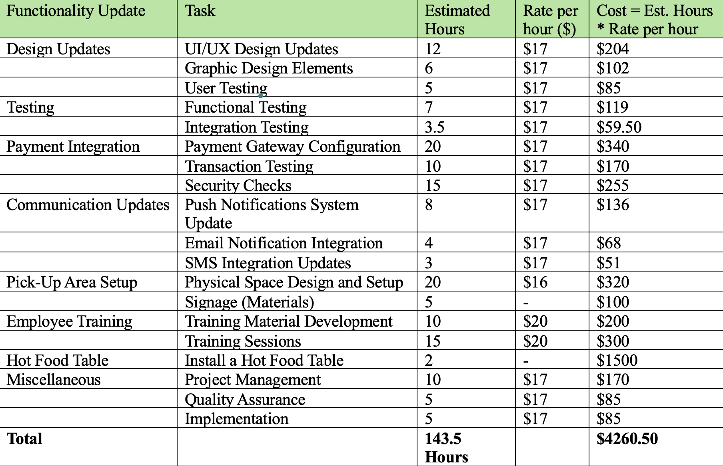
Strategic Improvement Proposal
Total cost ~ $4260.50
$17/hr – Division of Information Technology (DoIT)
$16 to $20 – Union South employee wages
Cost Analysis
Notes:
Adi

Slide 15
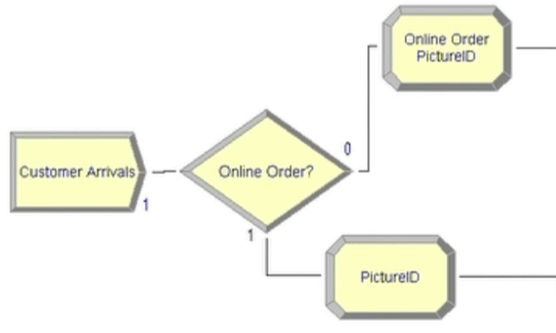
Strategic Improvement: Sensitivity Analysis
Completed for strategic improvement
Initial condition: 33% are online orders
Why did we decide to use this number?
Input change: Varying demand in online orders
Notes:
Adi
Why? Online resources, ex employee of Chipotle (chipotle is a similar system)

Slide 16
Strategic Improvement: Sensitivity Analysis
"True" percentage in decision module altered to 20% and then 40%
Maximum Queue Length across replications is insensitive to input change
Avg. maximum queue length is insensitive to lower percentages but is more sensitive to an increased percentage of online orders.
Notes:
Adi

Slide 17
Recommendation: Tactical vs Strategic Improvement
System Type | Decrease in Maximum Queue Length | 95% Confidence Interval
Tactical Improvement and Baseline | 3.35 | [3.03,3.66]
Strategic Improvement and Baseline | 2.60 | [2.27,2.92]
Tactical
Strategic
$500.00
$4260.50
Notes:
Adi
Figure out a script for this

Slide 18

Summary
Implementation of employee training to follow conveyer system is recommended (Tactical Improvement)
Meets the project's goals by:
1. Significantly reducing queue length
2. Improving customer service
3. Improving the system at a minimal cost
Notes:
Olivia

Slide 19
Thank you!

